Slide 1
Excel foundations final assessment LVADSUSR181-rituraj-anand

Slide 2

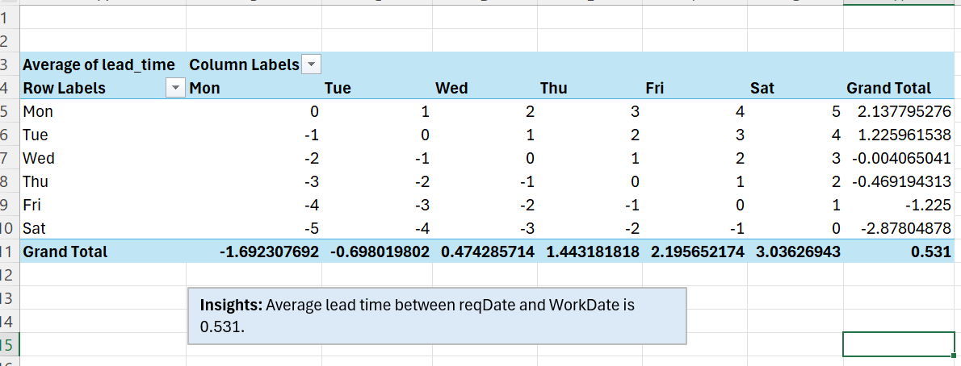
Question

Slide 3
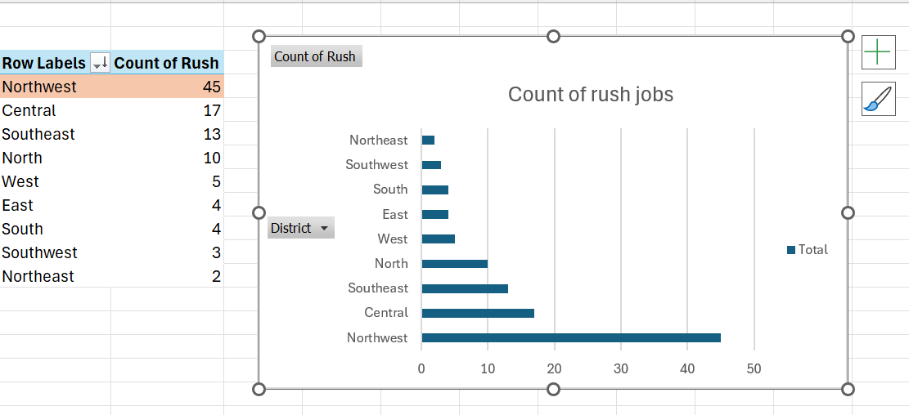
Question

Slide 4

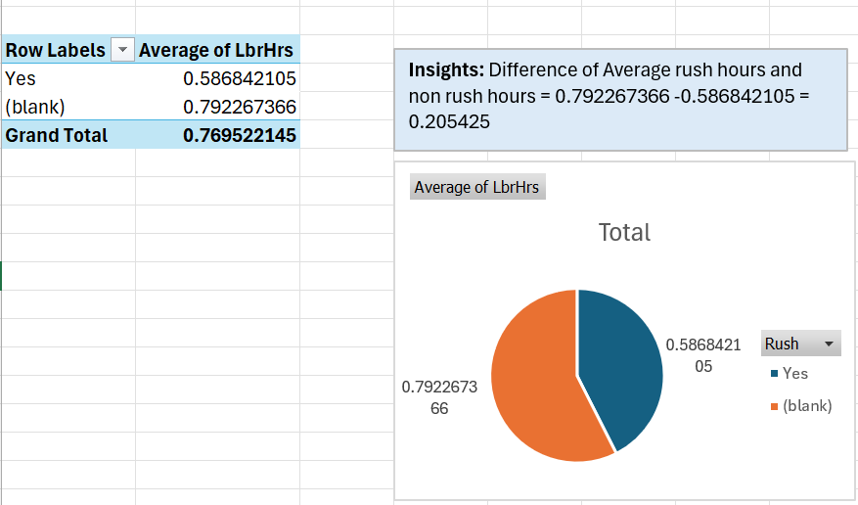
Question

Slide 5

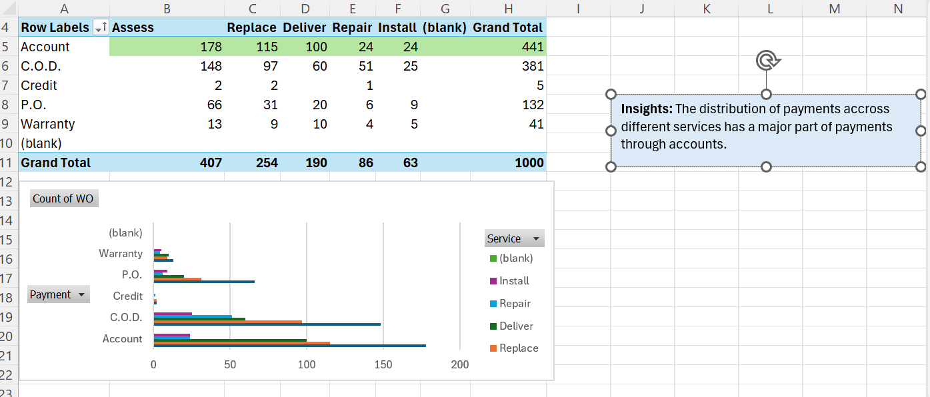
Question

Slide 6

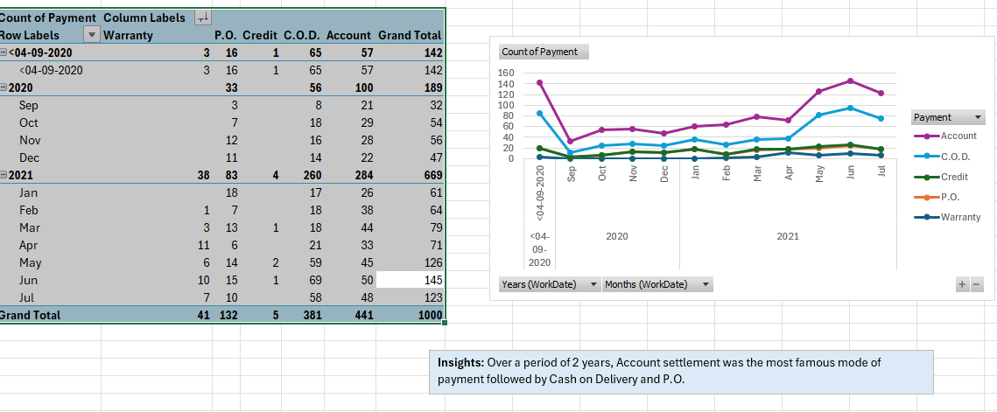
Question

Slide 7

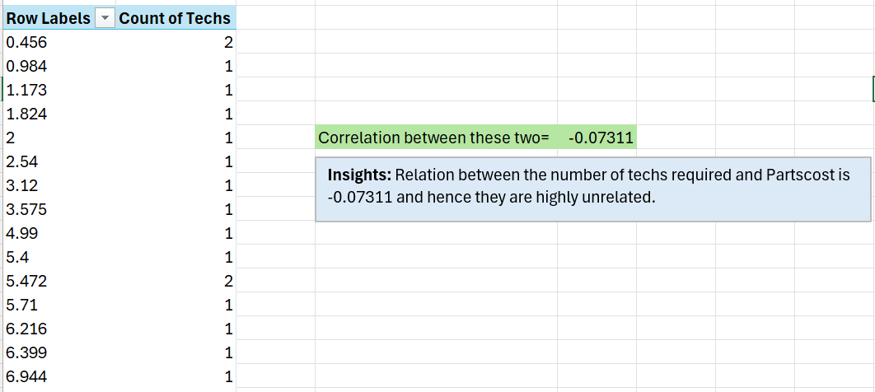
Question

Slide 8

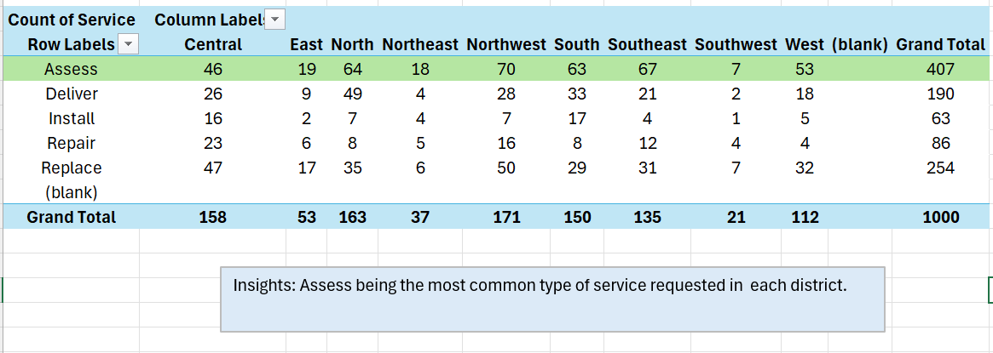
Question

Slide 9

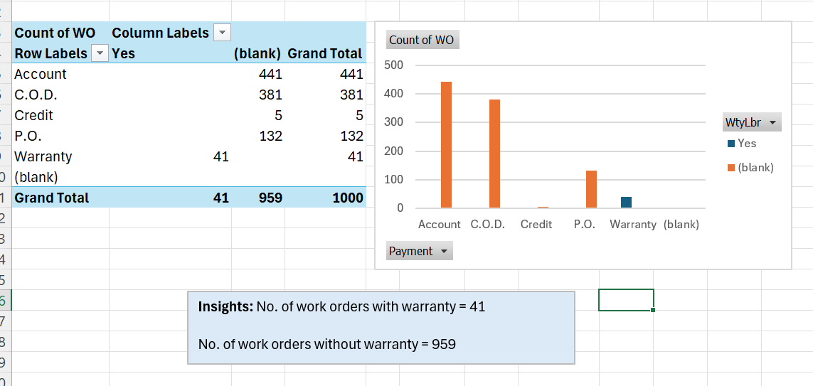
Question

Slide 10
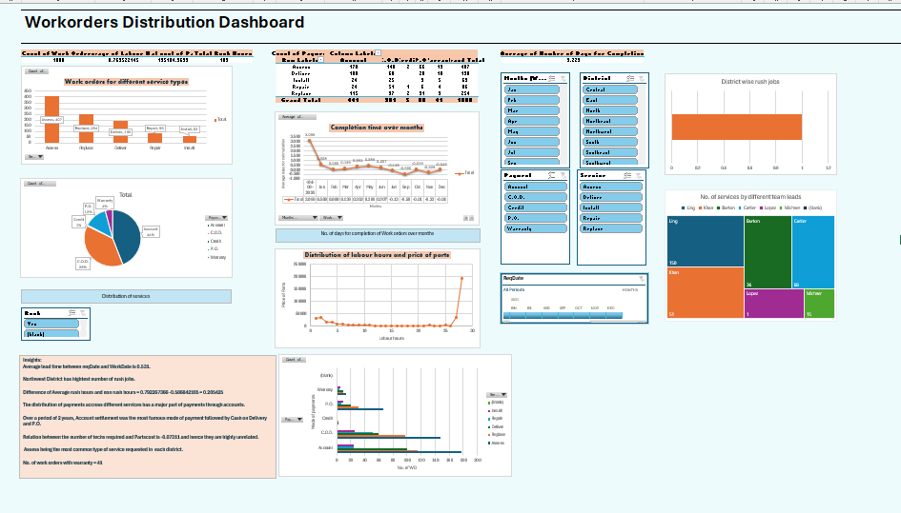
Question-9) Dashboard

Slide 11
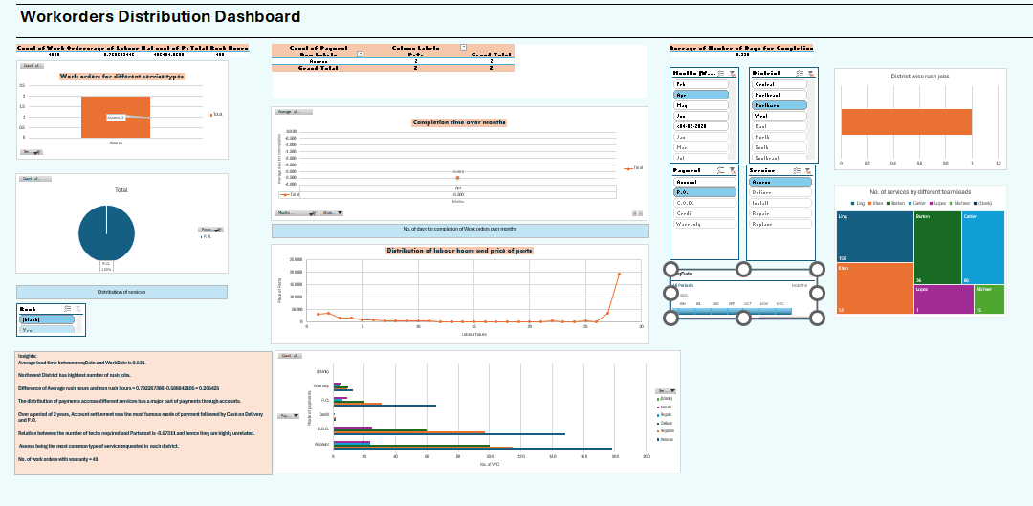
Dashboard

Slide 12
Thankyou LVADSUSR181-Rituraj-Anand

